Slide 1


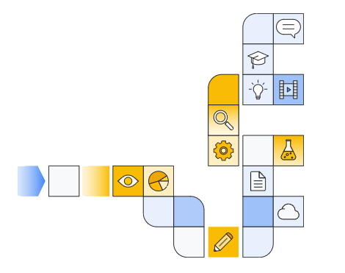

Notes:
https://www.cloudskillsboost.google/paths/183/course_templates/542/

Slide 2
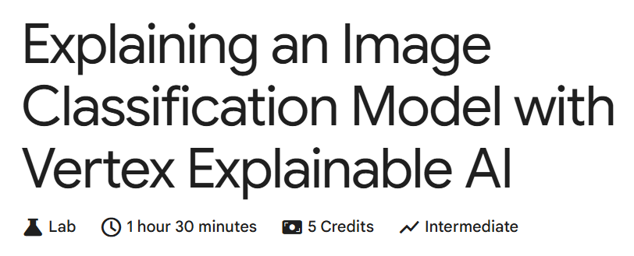

Slide 3
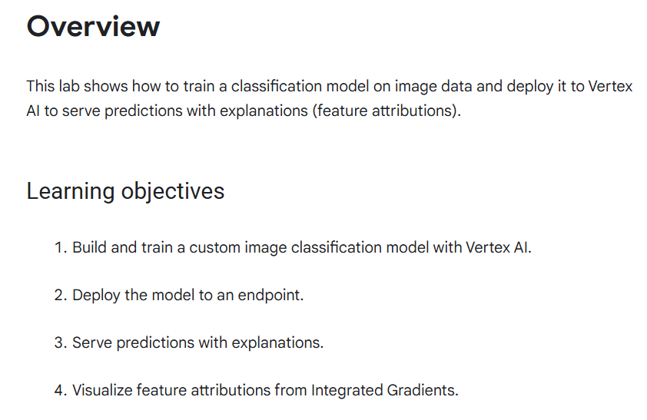

Slide 4


